Slide 1
Why Visualize Data Anyway?
John F. Tripp

Slide 2
Why Visualize Data Anyway?
Why a course in data visualization?
  Raw data (e.g., numbers) can be interpreted rather easily, as long as we are talking about one or a few data points:
    A particular temperature, on a particular day, at a particular time.
    Today’s stock price

Slide 3
Why Visualize Data Anyway?
BUT…as soon as the question involves the comparison of sets of numbers to each other…
  Human perception breaks down
  Human brain isn’t well equipped to compare groups of numbers.

Slide 4
Why Visualize Data Anyway?
The sheer scale of data available today makes understanding nearly impossible without help.
  In 1982, John Naisbitt wrote: “We are drowning in information but starved for knowledge.”
  Today, the problem is worse – we are drowning in data, and we often can’t generate insight.

Slide 5
The Key Question…

Slide 6
“COMPARED TO WHAT?”

Slide 7
Compared to What?
What do these numbers mean?
  98.6
  32
  911
  451
  70.6
How do we know if the level of a number is “good” or “bad”?

Slide 8
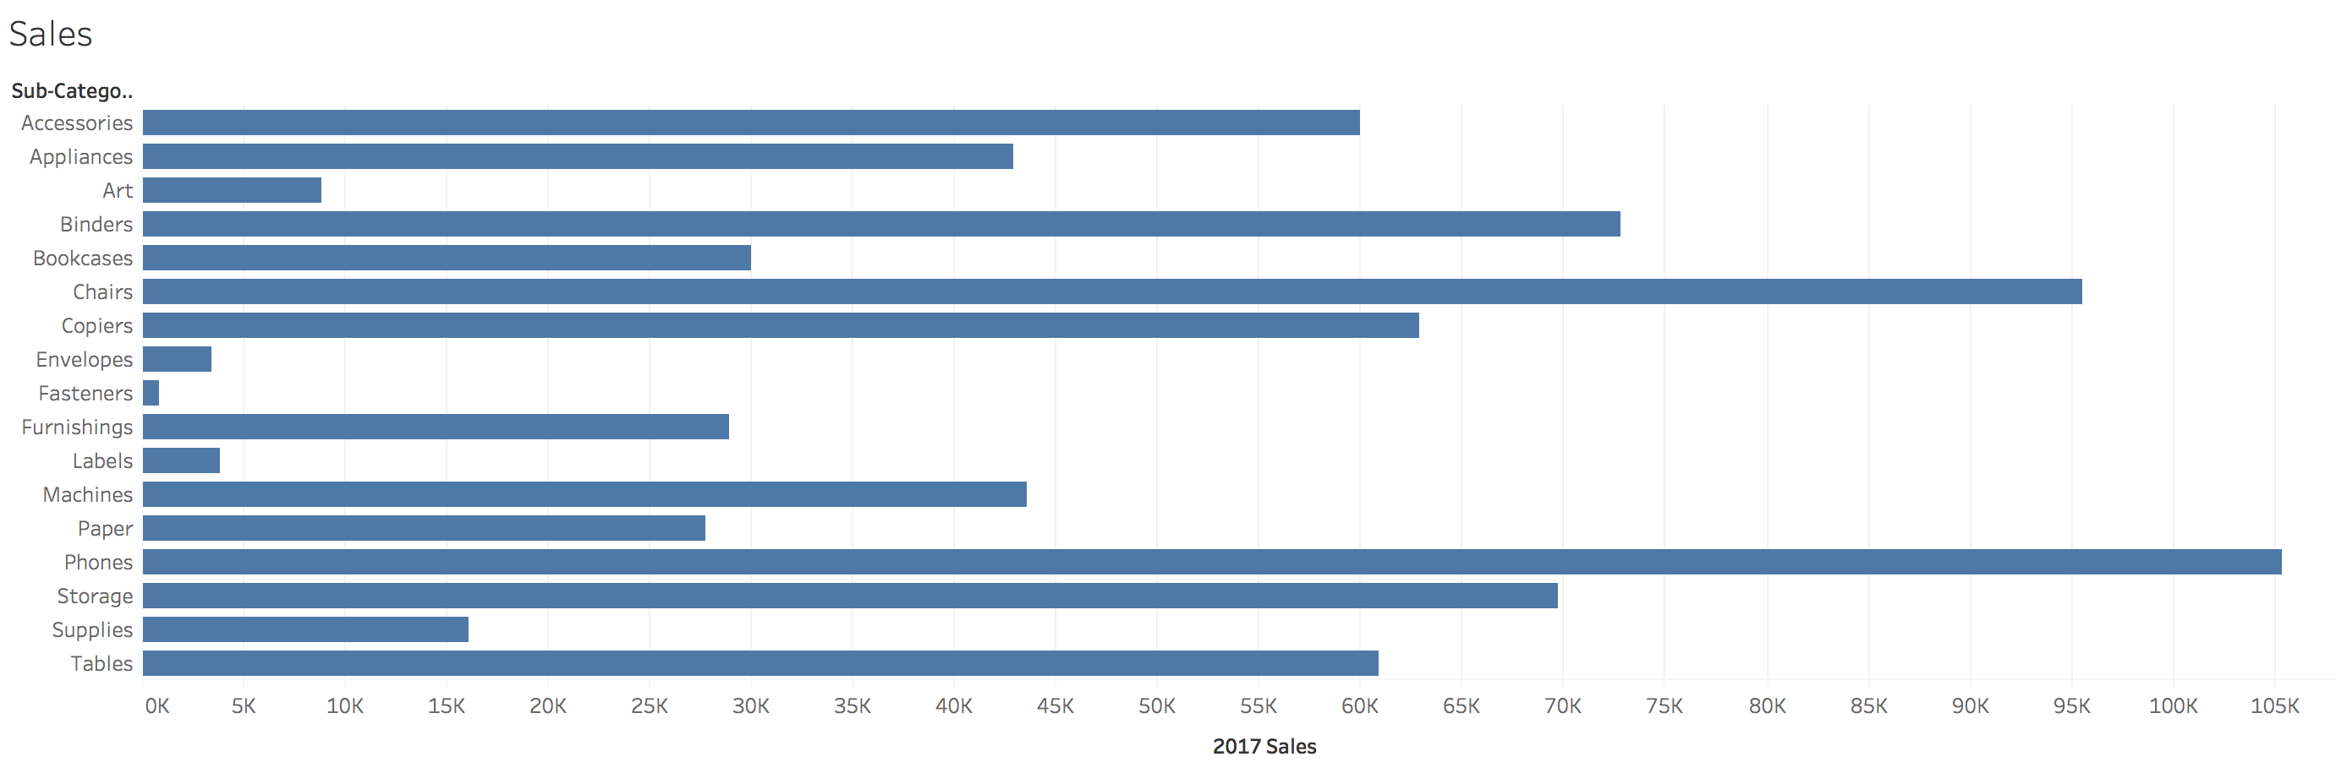
Metrics vs. Data
What question(s) can we answer with this graph?

Slide 9
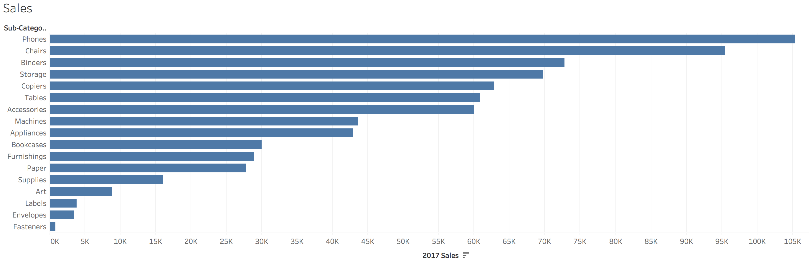
Metrics vs. Data
What question(s) can we answer with this graph?

Slide 10
Delivering Metrics
Most data visualizations that we design for others are not exploratory.
  They have an intended message.
To deliver a message, we must provide more than the data – we must display metrics (i.e., Is this number “good” or “bad”, and “how much”)

Slide 11
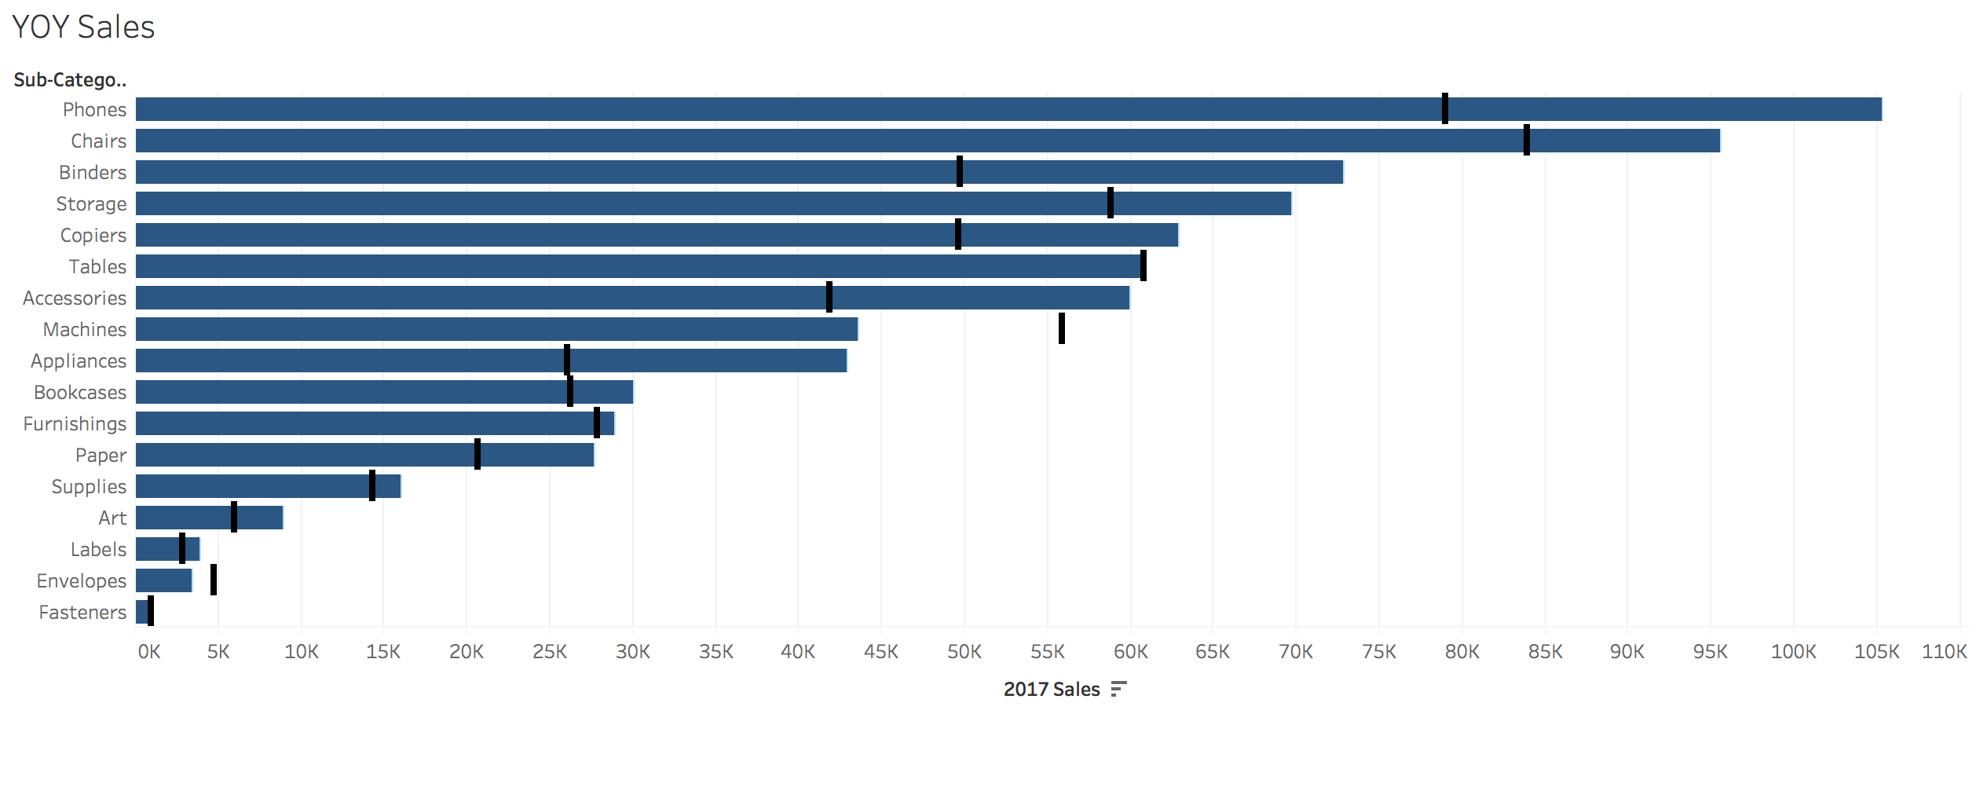
Metrics vs. Data
What question(s) can we answer with this graph?

Slide 12
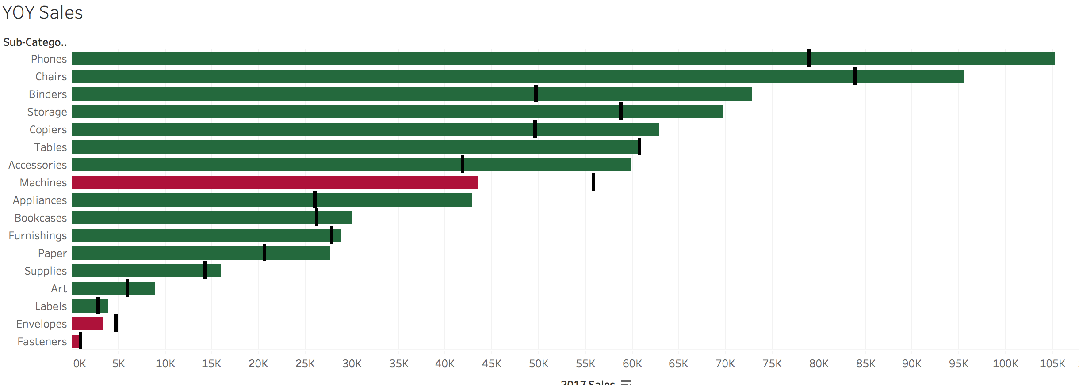
Metrics vs. Data
What question(s) can we answer with this graph?

Slide 13
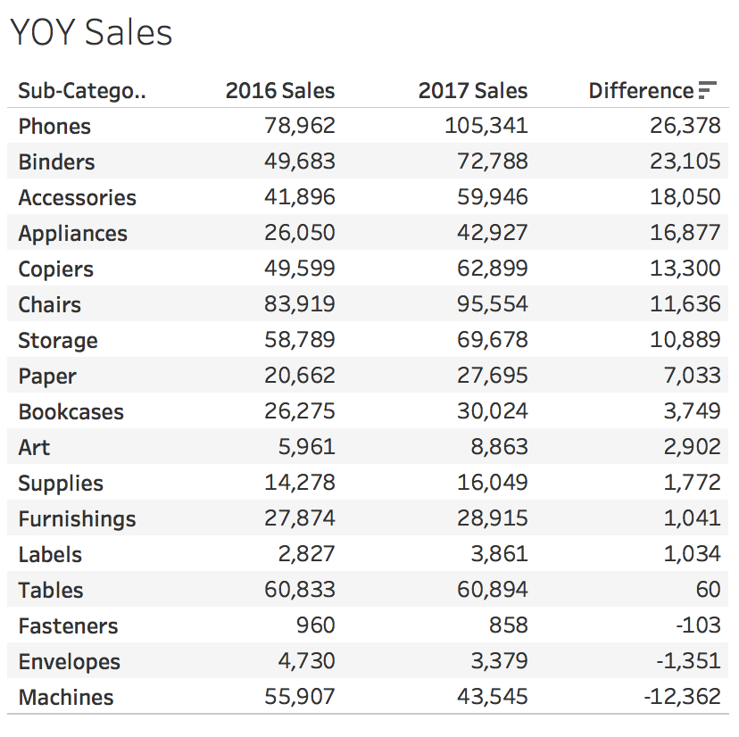
Metrics vs. Data
What question(s) can we answer with this table?

Slide 14
Compared to What?
We perform data visualization because:
Humans are hard-wired to make comparisons… visually.

Slide 15
Why Visualize Data At All?
Data visualization allows data to be presented both graphically and interactively.
  This is a rather recent development.
    Data tables emerged more than 1800 years ago.
    Graphical representations only 300 years ago.
  Technology has only recently made graphical representation of data accessible to individual users on their desktops.
    This has led to an explosion of data visualization.
      Some better than others…

Slide 16
Why Visualize Data At All?
Human visual perception can process a huge amount of data pre-consciously and consciously
We can manipulate visual attributes to encode multiple data fields
  Size
  Placement
  Color
  Shape
  Motion
By using these attributes, visualization can communicate things nearly intuitively.

Slide 18
How is this graph manipulating visual attributes to encode multiple data fields?
  Size
  Placement
  Color
  Shape
  Motion

Slide 19
Color Trends Graph
Placement irrelevant.
Size differences don’t match the data.
Is actually two different graphs, but unclear.
Visualization adds nothing to perception.

Slide 20
Why Visualize Data At All?
The human brain is exquisitely designed to process and interpret visual input.
Some data signals can only be interpreted visually.
This class will put you on the path to the proper construction and use of the incredibly powerful data visualization tools currently available.

